Slide 1
Programming Skills Workshop
Lesson 3 – Windows Command Prompt

Slide 2
Course Schedule
Tues 22nd – Intro
Wed 23rd – Windows Administration
Thu 24th – Windows Command Line
Wed 30th – Programming Tips & Tricks
Thu 31st – Programming Tools
Wed 6th – Linux
Thu 7th – More Linux & Languages
Wed 13th – Group Work & More Tools
Thu 14th – Open

Slide 3
Course Resources
Course items up on GitHub
https://github.com/kcarta/programming-workshop
These will be updated weekly

Slide 4
Today’s Lesson
Introduction to the Command Line
What you’ll learn:
Skills: Using a computer from a command line.
Knowledge: Lots of text commands and how they work together.
Values: Anything you can do in a graphical interface, you can do in a command line.

Slide 5
The Command Line

Slide 6
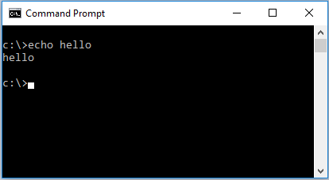
Command Line
Many modern applications run in a graphical interface (GUI), where the user interacts using forms and buttons.
As a programmer, you’ll find that many of the applications you want to use are too simple for a GUI.
These programs run on the command line.

Slide 7
Using the Command Line
Working on the command line couldn’t be simpler:
Just write a command, hit enter, then read the response!
You’ll see example commands written like this:
> command argument1 argument2
‘>’ Tells you where you should start writing. In your case, there will be some text before the >. This is your current location.
‘command’ is the actual command to write exactly as shown.
‘argument1’ and ‘argument2’ may or may not be shown, and can (usually) be up to you.

Slide 8
Opening the Command Prompt
Command Prompt can be opened in many different ways, including:
Press and search for cmd.
Open File Explorer, go to any folder, then click “File->Open Command Prompt”
For some operations, you might need to run as Administrator.

Slide 9
Customizing the Command Prompt
For your first command, type:
> title I am amazing
(Press enter to run this command)
Can you see what happened?
You just used the command line! Congratulations!

Slide 10
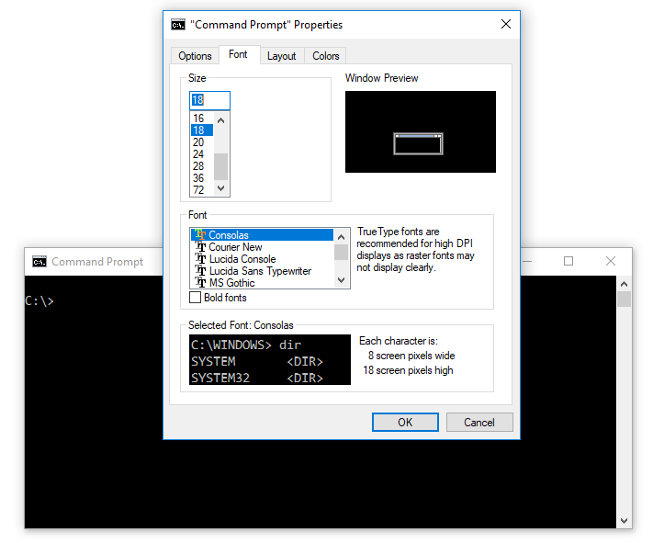
Customizing the Command Prompt, cont’d
The Command Prompt window has many configuration options (especially in Windows 10).
To get to Properties, click on the icon in the upper-left corner of the window and select ”Properties”

Slide 11
Navigating on the Command Line
Anything you can do in File Explorer can be done on the command line
In Command Prompt:
List the contents of the current directory:
> dir
Change to a different directory:
> cd directory-name

Slide 12
Navigating on the Command Line, cont’d
We now know that cd lets us change directories.
But how do we go ‘back’?
Easy!
.. refers to the folder above you (the parent directory)
So
C:\Users\> cd ..
will take you to the folder above you, in this case C:\

Slide 13
Navigating on the Command Line, cont’d
cd can get tedious if we have to type it many times in a row.
If you know the full path (or even just part of it) to the directory you’d like to move to, you can use \ to combine directory names
C:\Users\MyUser\Documents> cd ..\Desktop
will first take you to MyUser, then to the Desktop folder

Slide 14
Tips – Command History
What if we want to repeat an earlier action? Can we be lazy?
At any command line, the up and down arrows on your keyboard will cycle through your previous commands. Beware that the second you hit one of these arrow keys, you will lose whatever you had been typing.
In the Command Prompt, hit F7 to see a pop-up with your entire command history. Cycle through this and see everything you’ve typed in the current session!

Slide 15
Tips – Tab completion
Typing full filenames is a pain in the butt. How can we be lazier?
The Tab key is your new best friend! It auto-completes based off the files and folders in your current directory.
Test this! (This time, don’t hit enter just yet)
> cd
Press tab, and see what happens.
What happens if you type the beginning of a file name, then hit tab?

Slide 16
Tips – Exiting Programs
It’s easy to run into frozen or long-running programs in the command line.
Pressing Ctrl+c sends an ”abort” signal to the currently running program and will return you to the command interface.
Test this!
> find ”a” war_peace.txt
Let’s get out of here! Press Ctrl+c to return to the console.

Slide 17
Exercise 1: Explore the File System (again!)
Now that you know a few commands, let’s poke around our file system!
Open up the Command Prompt
Navigate from your current location to C:\ (Hint: use ..)
Use cd and dir to look at your file system in a completely new way.
Navigate from C:\ to the AppData folder in your User directory.
Navigate back to C:\ (Can you do this in a single command?)

Slide 18
Command Line Configuration & Tools

Slide 19
The PATH
The PATH is a simple variable that tells Windows where to look to find programs that run on the command line.
To check your current PATH, type:
> path
To change the PATH, go to :
System -> Advanced System Settings -> Environment Variables
In the System variables box, click on Path and then select Edit...
Note that you must separate directory paths by using a ; character

Slide 20
Command Line Programs
Navigating and modifying the file system is just one little aspect of command line use (eventually you won’t even realize you’re doing it).
From the command line you can access a number of built-in tools, as well as run any program. Many programs are built specifically to run on the command line.

Slide 21
Using Command Line Programs
To run a program on the command line, it either needs to be in the current directory or listed in the PATH variable.
In both cases, running a program is as simple as typing the name of the program, followed by any options or arguments that it might need.
Examples:
> ping www.google.com
> ipconfig

Slide 22
help
How can you find out what you can do? How can you get more information about what a command does?
On its own, help displays available commands
> help
help <command> prints the help options for a command
Same as the /? or –h arguments (it varies what commands and programs use)
> help cd

Slide 23
echo
echo <message> prints a message
> echo hello there!
echo [ON or OFF] will turn echoing from commands on or off
This means commands won’t print output. Be careful!
Try turning all echo off by > echo off
You can fix this with > echo on

Slide 24
type
Displays the contents of a text file. Everything is printed immediately.
1. Create a text file with: > echo “hello world!” > test.txt 2. Read it with: > type test.txt

Slide 25
more
What about very longe files? more prints as much of a file as fits on the screen.
Important functions:
Enter goes to next line
q to quit
> more war_peace.txt

Slide 26
find
Searches a file for a keyword and prints the line
> find “main” HelloWorld.java
> find “balcony” war_peace.txt
Very useful with piping – can take input from other commands
Can also print all lines but the ones with the keyword
Fun fact! Can be used for large files but it will only search on the first 1070 characters on each line

Slide 27
tree
Recursively displays the file structure
Recursively means down from the target directory
/F argument will also print all files
By default it only prints directories
Try running:
> tree c:\ /F
Remember that Ctrl + c will exit a running program

Slide 28
Command Line Working with files

Slide 29
Creating and removing files
Navigating and using tools and programs is great! But what about working with files and folders? Of course you can do that too!
Make a new file (cmd has no command for this, so we make our own):
> echo > file-name
Remove a file:
> del file-name

Slide 30
Creating and removing folders
The commands for working with folders are straightforward.
Create a new folder:
> mkdir folder-name
Remove a folder (must be empty):
> rmdir folder-name
Remove a folder and everything in it (Warning! Extremely violent!):
> del /q folder-name
> rmdir folder-name

Slide 31
Manipulating files and folders
Moving, renaming, and copying files and folders is also very easy.
Move a file or directory:
> move item-name destination
Rename a file or directory:
> rename item-name new-item-name
Copy a file:
> copy file-name new-file-name
Copy all files in a directory:
> copy folder-name destination

Slide 32
Command Line Using Operators

Slide 33
Input and Output
By now, you should have noticed that command line programs take input and produce output.
By default, a program’s input is given to it manually by the user, and the output is printed to the screen as text:
> echo ”this is a string of words”
will print to the screen, and return you to the command prompt.
You’ll soon start wanting more – can you write multiple commands at once? Can you send the output of one command to another?
The answer is yes! Using operators.

Slide 34
Chaining Operators
&& and | allow you to chain commands together
&& simply executes commands one after another
(as long as the first command ends successfully)
> mkdir folder-name && cd folder-name
| (”pipe”) sends the output of the first command to the second
> tree C:\ | more

Slide 35
Redirect Operators
> and >> redirect output from a command to a file
> redirects output from a command and writes it to a file, overwriting any preexisting file
> dir > directory_listing.txt
>> does the same thing, but adds to a preexisting file instead of overwriting it
> echo most orchestras are just 1800’s cover bands >> stupidshowerthoughts.txt

Slide 36
Wildcard Operator
* Is a “wildcard”, and is used for matching input
*.txt will match all files that end with .txt
special_name* will match all files that start with special_name
directory_name\*.docx will match all .docx files in a directory
The * operator is extremely handy for dealing with files as a batch:
> del *.txt
> move *.docx %USERPROFILE%\Documents

Slide 37
Command Line Java

Slide 38
Command line Java
You don’t need to use Eclipse to compile and run your Java programs!
The programs you want to use are simply called javac and java. If these programs are included in your PATH variable, you can use them from your command line.
To compile a .java file:
Create a file containing a valid Java program.
Run javac on the file. The Java compiler will create a new .class file.
To run a compiled Java program:
Run java on the .class file. Be sure to omit the .class extension.

Slide 39
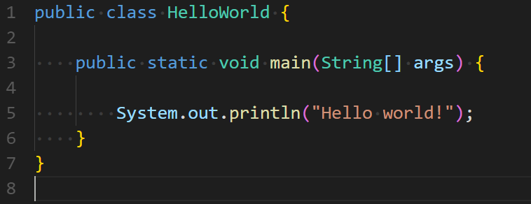
Create a text file called HelloWorld.java
Be careful about which letter are capital!
Don’t name it HelloWorld.java.txt!
Open the file in notepad and write following text into it
Open cmd in the same folder as the file and compile it with > javac HelloWorld.java
Run the program with > java HelloWorld

